Slide 1
Harmonization of employment related variables across surveys (HIES and LFS)
GCC.STAT preparatory Workshop on The Implementation of the Harmonized Survey of Household Income and Expenditure in the GCC Countries
Mabelin Villarreal-Fuentes

Slide 2
Contents
1. Background: why and how to improve harmonization between HIES and other household surveys?
2. Harmonization of labour related concepts and definitions using household surveys – HIES and LFS case
3. The ILO work on harmonizing employment related variables using household surveys (LFSs, HIES, etc).

Slide 3
Background: why and how to improve harmonization between HIES and other household surveys? (1)
Why: Benefits of harmonization between HIES and other household surveys at the national level
Possibility of improving comparability of derived estimates from HIES and the national HH survey (LFS).
Enhances the complementarity of outputs obtain with HIES and LFS (surveys have more detailed modules depending on their objectives).
Increases the possibility of being internationally comparable if international recommendations are implemented.
Reduces the replying burden to the respondent as the concept or definition is the same across HH surveys
Increases the possibility of survey-to-survey imputation to fill data gaps.

Slide 4
Background: why and how to improve harmonization between HIES and other household surveys? (2)
Results drawn from HIES surveys should aim at being comparable and consistent with other statistics at the national level.
Why: Input versus Output harmonization
Input | Output
Aim at harmonization of the underlying statistical methodology, the concepts and definitions as well as procedures (and questionnaires) used in common topics (core variables). → enhances comparability and consistency between surveys | Aim at harmonization of statistical results. Can be done for a restricted set of survey variables. Diminish harmonization of statistical outputs (final estimates; cross-tabulations). → Less reliability and accuracy of the harmonization, and it is limited to the statistical results produced.
Notes:
For output harmonisation. Countries are free to choose the methodology to be applied

Slide 5
Background: why and how to improve harmonization between HIES and other household surveys?
How: What to take into account when aiming at HIES and LFS harmonization?
Invest in the adoption of internationally agreed standards and guidelines (e.g. those from the ICLS); in case of deviations due to national contexts, aim at implementing consistently across surveys.
Include common questions across surveys and censuses for survey-to-survey imputation to fill data gaps, complement or derive new indicators.
Invest in the capacity building for CAPI, phone, web, mixed-mode surveys.
Quantify the benefits obtained from HIES survey and convey the message of the value of having such surveys (e.g. main source for indicators on consumer price (CPI) or indicators on the working poor.

Slide 6
2. Harmonization of labour related concepts and definitions using household surveys – HIES and LFS case (1)
Harmonization of underlying general and labour related concepts and definitions at the microlevel data, making use of the survey questionnaire(s) and related documentation, that collect individual data in modules aiming at covering same topics (e.g. employment). The harmonization should also aim at using the same classifications.
- Number of questions used to define a particular concept + categories and number of categories within the variables
Whenever possible, harmonization of: Sampling design, data imputation methods (rents, own production..), treatment of non-response, reference period. Also, coding books, methodological documentation, survey manuals/instruction manuals, user guides.

Slide 7
2. Harmonization of labour related concepts and definitions using household surveys – HIES and LFS case (2)
Labour related concepts and definitions at the international level:
Variable | Description
Level of education | Highest level of education of the respondent should be coded following ISCED 11 (UNESCO), or ISCED 97 (second best option).
Place of birth | Divides the population into 2 categories: native-born (people born in the country) and foreign-born (people born abroad)
Citizenship | Divides the population into 2 categories: citizens (people holding the citizenship of the country) and non-citizens (or foreigners: people holding the citizenship of another country)
Disability status | Follows the Washington Group recommendation, at least 4 core questions (difficulties in seeing, hearing, walking and remembering)
Working-age population | Persons aged 15 years old and more (19th ICLS resolution)

Slide 8
2. Harmonization of labour related concepts and definitions using household surveys – HIES and LFS case (3)
Labour related concepts and definitions at the international level:
Variable | Description
Labour Force Status | Divides the working-age population between employed, unemployed, outside the labour force according to the 19th ICLS resolution. The three categories of labour force status are mutually exclusive and exhaustive. The sum of persons in employment and in unemployment equals the labour force.
E.g. set of questions to identify labour force status

Slide 9
2. Harmonization of labour related concepts and definitions using household surveys – HIES and LFS case (4)
Labour related concepts and definitions at the international level:
Variable | Description
Degree of Labour market attachment | Following the definition in the 19th ICLS resolution (available and accurately defined if the components to define unemployment are included)
Status in employment | International Classification of Status in Employment, ICSE 93, or the ICSE 18, adopted during the 20th ICLS in 2018. For main and secondary job.
Economic activity | International Standard Industrial Classification, ISIC Revision 4 or Revision 3.1 (or prior revisions, but not recommended)
Occupation | International Standard Classification of Occupations ISCO 08, or, ISCO88 (second best option)

Slide 10
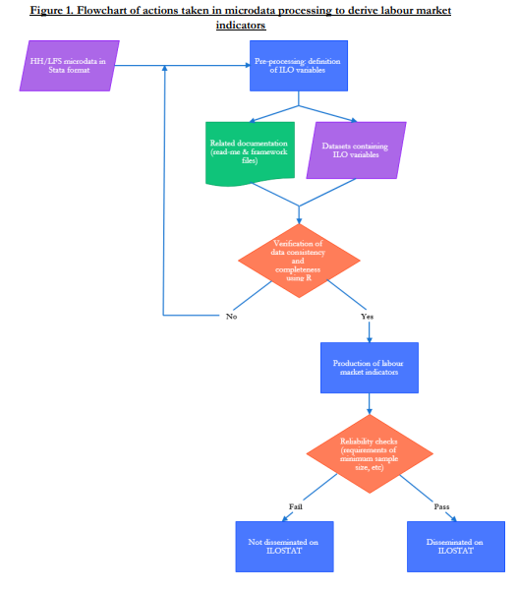
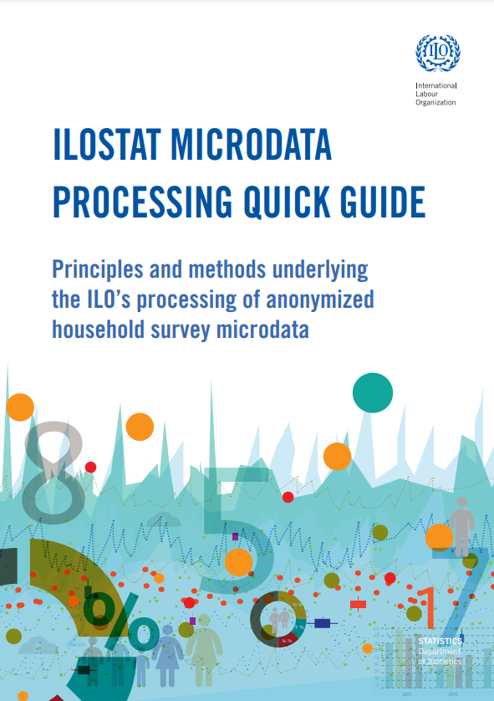
3. The ILO work on harmonizing employment related variables using anonymized household surveys (LFSs, HIES, etc)
https://www.ilo.org/wcmsp5/groups/public/---dgreports/---stat/documents/publication/wcms_651746.pdf

Slide 11
Thank you!
https://ilostat.ilo.org/

