Slide 1
International Best Practices
Workshop on Harmonized Household
Income and Expenditure Surveys in the GCC
May 25, 2022

Slide 2
Contents
Overview and focus
World Bank LSMS
Some examples
Tools and data sources
GCC practices
Workshop on HIES in the GCC

Slide 3
Overview and focus
Household survey
ILO and this workshop laid out many best practices
LSMS and other international resources
GCC particularities
Foreign labor
Distribution

Slide 4
LSMS
The program supports production of high-quality, multi-topic household survey data that measure welfare and other key socioeconomic indicators.
Forefront of survey methodology, the LSMS conducts cutting-edge research on best practices in survey methods.
Broader welfare-orientation rather than just MFCE

Slide 5
LSMS
A modular, multipurpose survey vehicle
Existing framework to plan over medium term
A flexible, on-going / annual
Survey methodology, including sampling, for target population/s
Modules on health, education, gender, socio-economic, ITC, SDG-monitoring, other policy-relevant topics as needed

Slide 6
Examples
Modeling household expenditure
Access to microdata
Reducing response burden
From survey results to final estimates

Slide 7
Tools and data sources
As discussed yesterday
What, where and how to collect
Covid forced some changes
→ Innovation and mixed-mode surveys

Slide 8
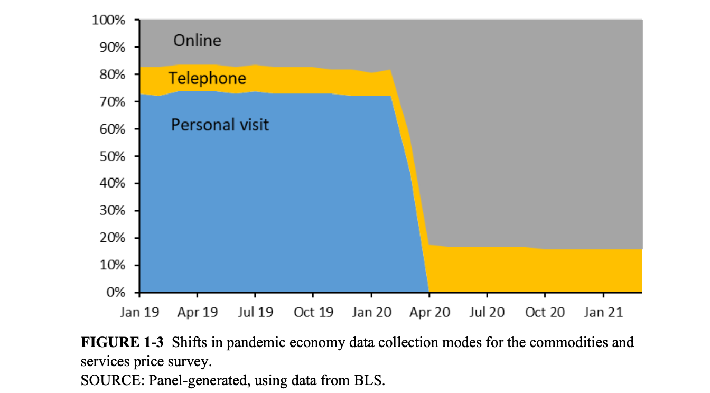
Tools and data sources

Slide 9
Tools and data sources
What data to collect?
Minimize survey coverage to areas resistant to other survey means
More detailed breakdowns from alternative data?
Aggregates from alternative data?
Where?
Admin, corporate, survey, combo
How?
Apps, web, CATI, CAPI
Linking different sources, modes together

Slide 10
GCC practices
National GCC HH survey program?
Adapted, common methodology
Based on international best practices
Concepts, sampling, validation, etc.
Driven by national needs and objectives
Common components like HIES easy to ‘plug-in’

Slide 11
GCC practices
Suggestions, existing plans
GCC experiences!

Slide 12
Thank you very much!

