Slide 1
UN Comtrade
Data Processing: CoprA+
Presentation by Vysaul Nyirongo
10 November 2020

Slide 2
Presentation Outline
UN Comtrade (+)
Data Processing System: CoprA+
  Form of data
  Data detail
  Harmonization
  Aggregation

Slide 3
UN Comtrade
https://comtrade.un.org/
Repository of official international trade statistics and some analytical tables
  Merchandise trade data (annual and monthly)
  Services trade data (annual)
Free access to extensive and detailed global trade data.
  42 billion records in Comtrade+
  Value and quantity by partner, MOT/MOS, CPC
  Web-based query
  API access
  Bulk files download

Slide 4
UN Comtrade Data Elements
Period
Reporter
[Year/Month]
Flow
Partner 1
MOT
CPC
Exports
Re-exports
Imports
Re-imports
Partner2
HS Code
Trade values
Imports: CIF, FOB
Exports: FOB
Net weight
Supplementary quantity & unit

Slide 5
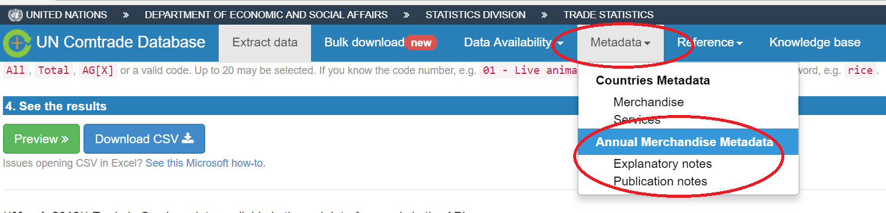
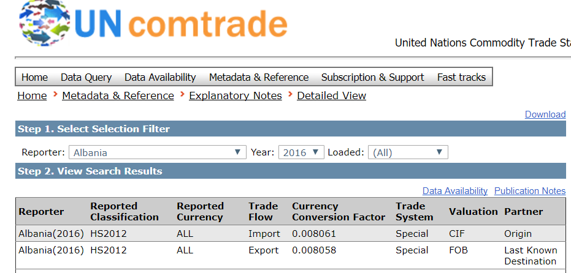
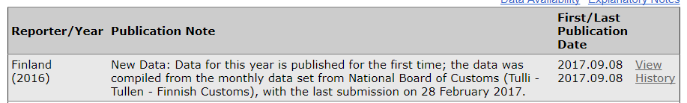
Metadata
Notes:
Explanatory notes: Info on Trade system, Classification, Valuation, Partner attribution
Publication note: Info on sources, revision

Slide 6
Available data dashboard (GCC countries)
data/da

Slide 7
Sources of Data
National Statistical Office
Customs Administration
Central Bank
Ministry
[Trade/Industry]
Secondary & Supplementary Sources
ITC, AU, GCC, OPEC (oil & gas data)
Notes:
BAHRAIN: Central Informatics Organization; Oil and Gas taken from country website (Central Informatics/Central Bank)
KUWAIT: Central Statistical Bureau
OMAN: National Centre for Statistics and Information (2017)
QATAR:Ministry of Development Planning and Statistics (2016); Qatar Statistics Authority (2014)
SAUDI ARABIA: General Authority for Statistics; 2016 Oil and Gas from OPEC’s Annual Statistical Bulletin
UNITED ARAB EMIRATES: National Bureau of Statistics; Oil and Gas from OPEC’s Annual Statistical Bulletin

Slide 8
Summary of Data Collection and Dissemination
Request
Official letter in February
New and revised
Receipts
FTP, Email, Cloud
Pre-processing
Transform to standard input format for CoprA+
Text, MS Access, Excel, other formats
Data registration in CoprA+
Python, Excel, Access, Notepad++
Processing
Normalize and harmonize
Quantity and weight estimation
Review &
Validation
Mappings
Publication
Dissemination
Comtrade (+)
Top partners, commodities
Bulk files
Convert into other classifications
Ttrade totals
Time series
Yearbook and other analytical products
Trade matrix

Slide 9
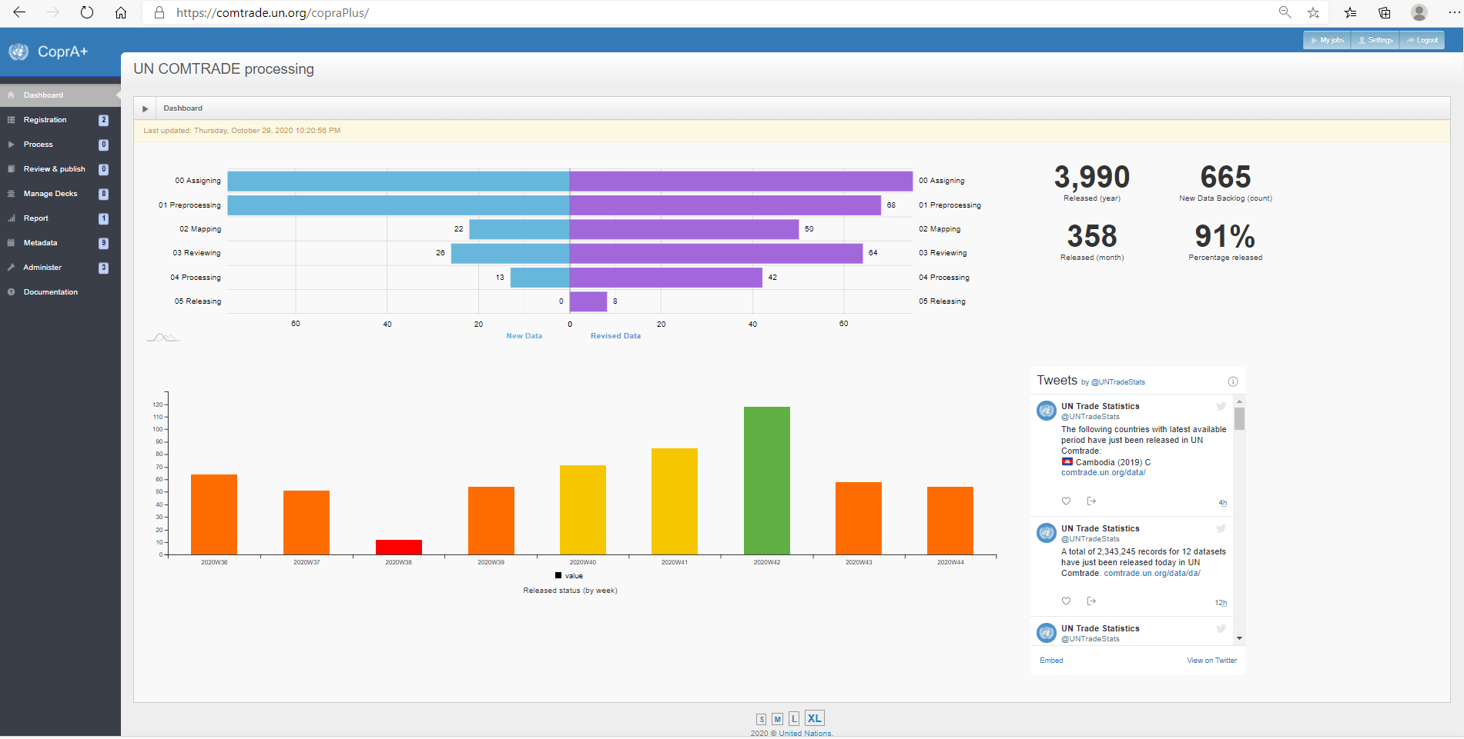
Data Processing: CoprA+

Slide 10
Pre-Processing
Transform national data into the input format required by the internal processing system (shape, form and format)
Ensure that national code references are included for map to standard codes during the processing stage
Ensure accuracy and validity
  totals; revision status
  inclusions/exclusion e.g. monetary gold; oil exports
  must include flow, ref period, commodity, reporter, and partner codes, value
Produce an output file in tab-delimited format
  retain original level of detail (no aggregation at this stage)
Notes:
Examples include:
some calculations e.g. to get CIF=Custom value + import charges (insurance and freight)
Treatment of confidential values

Slide 11
Some Challenges in Pre-Processing
National code references not being provided
National languages
Oil exports not available for some oil exporters
Lack of detail
  commodities not in 6-digit level; no partner detail; confidential data
High percentage of invalid commodity codes resulting big residuals

Slide 12
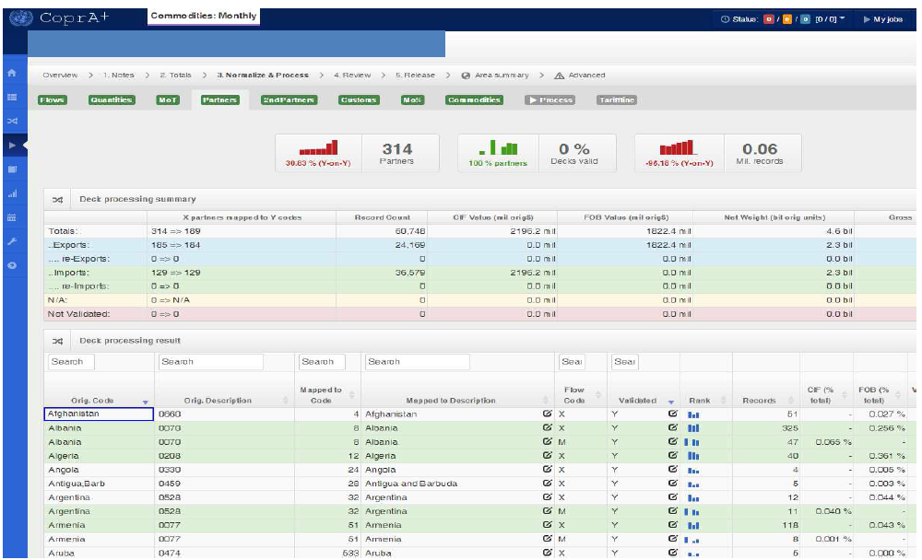
Processing: Harmonization & Normalization

Slide 13
Harmonization and Normalization
National data items are mapped to standard codes
  Partner names or codes to M49 codes
  Quantity units to World Customs Org (WCO) recommended units and UNSD extended units
  Mode of transport to UNSD units
  Revised Kyoto Convention for Customs Procedure Codes
  Currency conversion to USD
Output tariff line data (can include 8-10 digit HS)
Notes:
WCO Recommended Units: 12
UNSD supplementary units: about 20

Slide 14
Quantity Information
Weight (net/gross) and supplementary quantity
Standardize quantity
  according to WCO recommended units and UNSD standard quantity units
  conversion factors based on mathematical or empirical relations
  (by the FAO or countries for specific commodities)
Detect outlying quantity information
Estimate missing or “outlier” quantity information, if possible

Slide 15
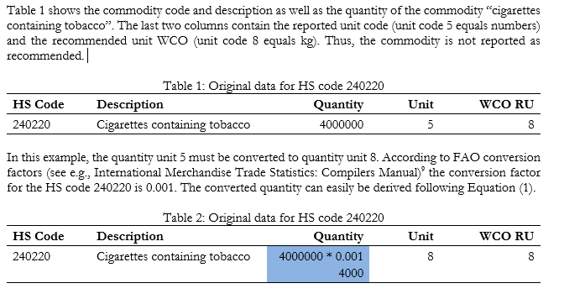
Example: quantity conversion

Slide 16
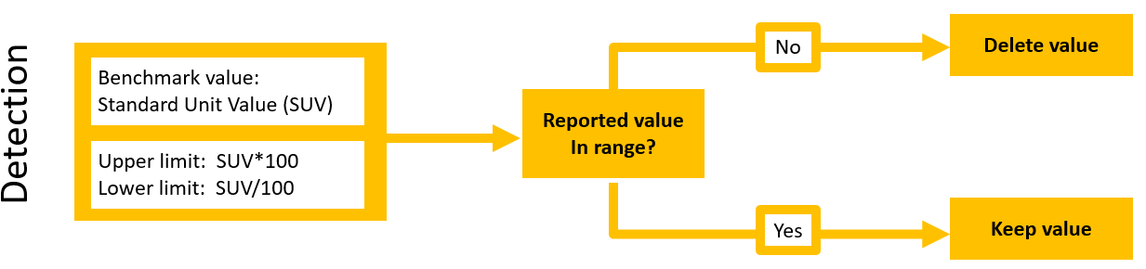
Extreme Quantity Detection

Slide 17
Quantity Estimation

Slide 18
Conversions to other Classifications
Data reported in latest HS classification is converted to:
- earlier versions of HS
- Standard Int’l Trade Classification (SITC )
- Broad Economic Categories (BEC)
Use WCO correlation tables between HS versions
  UNSD developed conversion tables
  prefer to convert most detailed level in original classification into one single code in the target classification, without splitting

Slide 19
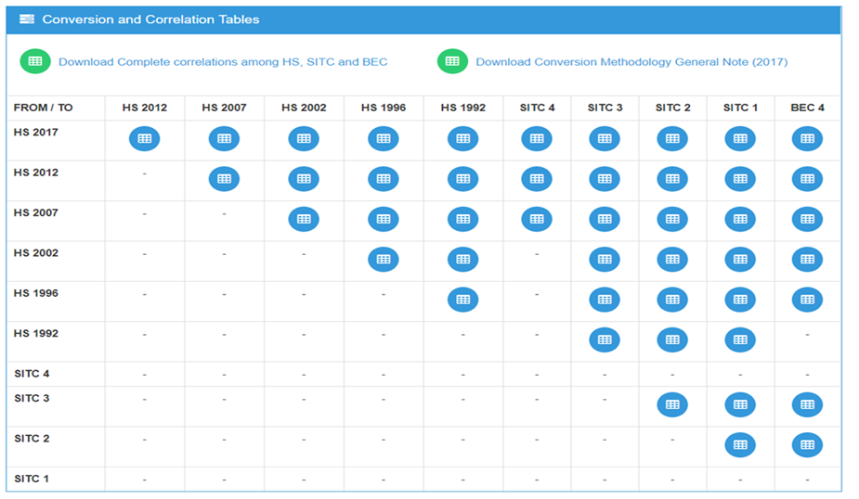
Conversions to other classifications
UNSD maintains matrix of correlations and conversions
http://unstats.un.org/unsd/trade/conversions/HS%20Correlation%20and%20Conversion%20tables.htm
Notes:
Users are welcome to establish their own conversion tables

Slide 20
Data Review
Reviews by editor and supervisor
Verify the mapping of partners, commodities and quantity units
Check overall totals against official sources, time series, trends
Check value of non-standard commodity codes or unknown partners
Check Copra+ reports, such as
  Upload Summary
  Total Time Series
  Top 10 Time Series
  Quantity Estimation Report

Slide 21
CoprA+ Reports

Slide 22
Data Release: https://comtrade.un.org/

Slide 23
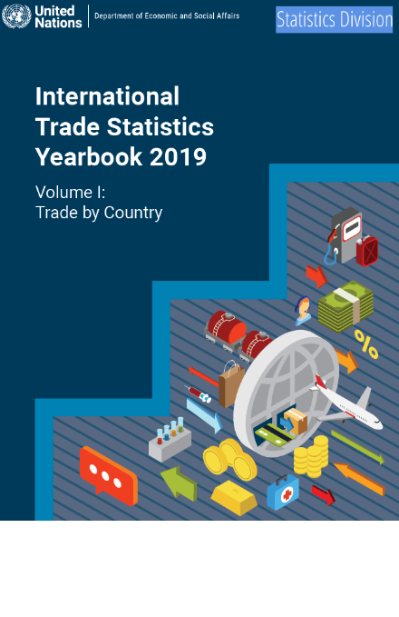
International Trade Statistics Yearbook
Volume I: Trade by Country in June
Volume II: Trade by Product (3-digit SITC) in December
World and Regional Trade Profiles

Slide 24



Other Analytical Outputs
Tables published in the UN Monthly Bulletin of Statistics (MBS)
 | Monthly: total imports and exports by regions and countries or areas Value and balance volume, unit value/price index
 | Quarterly total exports and imports by countries or areas: volume, unit value, terms of trade and purchasing power of exports external trade conversion factors total exports and imports by regions: quantum and unit value indices and terms of trade manufactured goods exports: unit value indices, volume indices and value fuel imports, developed economies: unit value and volume indices; value indicators on fuel imports, developed economies
 | Annual world exports by provenance and destination exports by commodity classes and by regions: developed economies world exports by commodity classes and by regions
12x
4x
1x

Slide 25
Thank you!
شكرا جزيلا

