Slide 1
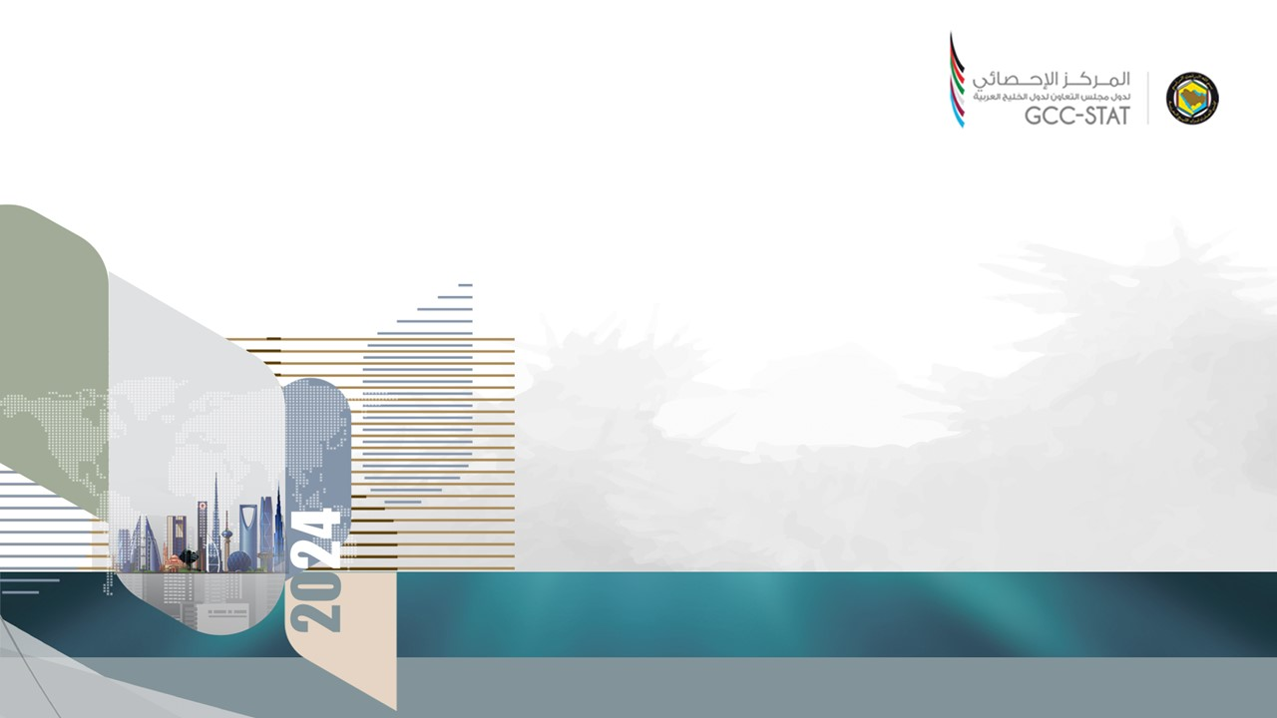
Seventh GCC Regional Seminar on Foreign Investment Statistics in cooperation with UNCTAD
الندوة الاقليمية سابعا حول إحصاءات الاستثمار الأجنبي بالتعاون مع الأونكتاد
الاستثمارات الخارجية العابرة من قبل/في دول مجلس التعاون الخليجي،
Pass Through Offshore Investments by/in the
GCC Countries
May 28, 2024
In Virtual Mode
28 يمكن 2024م
(باستخدام الوسائط الإلكترونية)

Slide 2

Foreign Direct Investment (FDI)
Foreign direct investment (FDI) is often an important driver for genuine international economic integration, stimulating growth and job creation and boosting productivity through transfers of^{*)}:
Capital,
Skills, and
Technology.
Therefore, many countries have policies to attract more of it.
The GCC member countries are no exception.

Slide 3
Investment Promotion Agencies in the GCC Member States
There are 11 investment authorities in the UAE that plan and regulate investments at the federal and local levels.
  https://u.ae/en/information-and-services/finance-and-investment/investment-schemes
The Bahrain Economic Development Board (EDB)
  The EDB is an investment promotion agency with overall responsibility for attracting investment into the Kingdom and supporting initiatives that enhance the investment climate.
  https://www.bahrainedb.com/
Emirates Investment Authority (EIA) Abu Dhabi Investment Council Investment Corporation of Dubai Sharjah Investment and Development Authority (Shurooq) Investment and Development Office of Ras Al Khaimah | Abu Dhabi Investment Office (ADIO) Dubai FDI Invest in the UAE Invest in Abu Dhabi Invest in Dubai Invest in Sharjah.

Slide 4
Investment Promotion Agencies (continued)
The Ministry of Investment for Saudi Arabia (MISA)
  To place the KSA among the top performing markets for investments.
  To promote Saudi Arabia as a world-class investment destination, attract and retain investors, and expand their investments; for the benefit of a sustainable national economic growth.
  To turn the KSA into an investment powerhouse by driving economic growth and diversifying the economy away from a reliance on oil.
  https://www.invest.qa/en
Saudi Investment Promotion Authority (SIPA)
  INVEST SAUDI is Saudi Arabia's nation-wide investment attraction and promotion brand. Overseen by the MISA, INVEST SAUDI facilitates investments in Saudi Arabia that support the country's economic growth and position it at the forefront of the global business world.
  https://www.investsaudi.sa/en

Slide 5
Investment Promotion Agencies (continued)
Invest OMAN
  Managed by Ministry of Commerce, Industry & Investment Promotion (MoCIIP), Invest OMAN is the government`s arm for large-scale investment opportunities across promising in Oman. It offers curated investment opportunities, incentives, and facilities tailored for investors. https://investoman.om/
Investment Promotion Agency Qatar (Invest Qatar)
  The Invest Qatar is responsible for overseeing investment promotion activities, aimed at attracting foreign direct investment into Qatar. Invest Qatar’s mission is to strengthen Qatar’s position as an ideal investment destination, while facilitating investments that foster economic diversification and development. https://www.invest.qa/en
Kuwait Direct Investment Promotion Authority (KDIPA)
  The KDIPA is mandated with the tasks of attracting value-added direct investment into Kuwait; promoting Kuwait as a lucrative investment destination; receiving applications for investment licensing and granting incentives; servicing investors; in addition to streamlining business environment and enhancing Kuwait’s competitiveness. https://kdipa.gov.kw/

Slide 6
FDI and Phantom Investments
FDI is usually perceived as long-term strategic and stable investment reflecting fundamental location decisions of multinational firms.
However, not all FDI brings capital in service of productivity gains. In practice, FDI is defined as cross-border financial investments between firms belonging to the same multinational group, and much of it is phantom in nature—investments that pass through empty corporate shells. These shells, also called special purpose entities, have no real business activities. Rather, they carry out holding activities, conduct intrafirm financing, or manage intangible assets—often to minimize multinationals’ global tax bill. Such financial and tax engineering blurs traditional FDI statistics and makes it difficult to understand genuine economic integration.^{*)}

Slide 7
Major Pass-Through Economies
An IMF study of 2017 by Jannick Damgaard and Thomas Elkjaer^{*)} found that a stunning $12 trillion—almost 40 percent of all FDI positions globally—is completely artificial: it consists of financial investment passing through empty corporate shells with no real activity.
The IMF study “Piercing the Veil” by Jannick Damgaard, Thomas Elkjaer, and Niels Johannesen, June 2018”published in June 2018, identifies eight major pass-through economies—the Netherlands, Luxembourg, Hong Kong SAR, the British Virgin Islands, Bermuda, the Cayman Islands, Ireland, and Singapore—host more than 85 percent of the world’s investment in special purpose entities, which are often set up for tax reasons. (https://www.imf.org/Publications/fandd/issues/2018/06/inside-the-world-of-global-tax-havens-and-offshore-banking-damgaard)

Slide 8
GCC FDI with Eight Major Pass-through Economies
Outward FDI Positions, 2022 Year-End ^{*)}

Slide 9
GCC FDI with Eight Major Pass-through Economies
Inward FDI Positions, 2022 Year-End ^{*)}

Slide 10
GCC FDI with Eight Major – CDIS Data
FDI Positions, 2022 Year-End: Inward for 8 Major / Outward for GCC

Slide 11
GCC FDI with Eight Major – CDIS Data
FDI Positions, 2022 Year-End: Outward for 8 Major / Inward for GCC

Slide 12
Offshore Financial Centre
An Offshore Financial Centre (OFC) is a country or jurisdiction that provides financial services to nonresidents on a scale that is incommensurate with the size and the financing of its domestic economy.^{*)}
The 2007 study identified 22 OFCs:
  Bahamas
  Bahrain, Kingdom of
  Barbados
  Bermuda
  Cayman Islands
  China Hong Kong
  Cyprus
  Guernsey
  Ireland
  Isle of Man
  Jersey
  Latvia
  Luxembourg
  Malta
  Mauritius
  Netherlands Antilles
  Panama
  Singapore
  Switzerland
  United Kingdom
  Uruguay
  Vanuatu

Slide 13
Offshore Financial Centres (OFCs)
Lists of Offshore Financial Centers According to the Financial Stability Forum (FSF) – first 42 Jurisdictions, and the IMF - 46 Jurisdictions.
1 Andorra
2 Anguilla
3 Antigua and Barbuda
4 Aruba
5 Bahamas, The
6 Bahrain
7 Barbados
8 Belize
9 Bermuda
10 British Virgin Islands
11 Cayman Islands
12 Cook Islands
13 Costa Rica
14 Cyprus
15 Gibraltar
16 Guernsey
17 Hong Kong SAR
18 Ireland
19 Isle of Man
20 Jersey
21 Lebanon
22 Liechtenstein
23 Luxembourg
24 Macao SAR
25 Malaysia (Labuan)
26 Malta
27 Marshall Islands
28 Mauritius
29 Monaco
30 Nauru
31 Netherlands Antilles
32 Niue
33 Panama
34 Samoa
35 Seychelles
36 Singapore
37 St. Kitts and Nevis
38 St. Lucia
39 St. Vincent and the Grenadines
40 Switzerland
41 Turks and Caicos Islands
42 Vanuatu
43 Dominica
44 Grenada
45 Montserrat
46 Palau

Slide 14
FDI with OFCs - CDIS Data
FDI positions, 2022 year-end: CDIS data of counterpart economieof their inward FDI (mirror statistics): Outward for the GCC

Slide 15
FDI with OFCs - CDIS Data
FDI positions, 2022 year-end: CDIS data of counterpart economies of their outward FDI (mirror statistics): Inward for the GCC

Slide 16
FDI with OFCs - CDIS Data
Meanwhile no data available for 23 OFCs, such as (no reports to the CDIS):

Slide 17
CORPNET Report
CORPNET Report: a report published in Nature in 2017 on the analysis of OFCs called: "Uncovering Offshore Financial Centers: Conduits and Sinks in the Global Corporate Ownership Network",^{*)} provided a quantitative and scientific approach to the classification of tax havens.
The results were published by the University of Amsterdam's CORPNET Group in 2017, and identified two classifications:
  24 global sink OFCs: jurisdictions in which a "disproportional amount of value disappears from the economic system" (i.e. the traditional tax havens).
  Five global conduit OFCs: jurisdictions "through which a disproportional amount of value moves toward sink OFCs" (i.e. modern corporate tax havens).

Slide 18
Conduit and Sink OFCs
Sink OFCs
Sink OFCs cover a broad range of locations from very small countries (e.g. the Marshall Islands), to major global financial centres (e.g. Hong Kong).
Just because funds reach a Sink OFC, does not mean that they remain dormant. Quite the contrary, the funds can be invested in assets all over the world, but their legal ownership and future gains remain in the Sink OFC. For example, the circa US$1 trillion of US company offshore cash is held in Sink OFCs (esp. the Caribbean).
Conduit OFCs
Conduit OFCs are described as having advanced legal and tax systems designed to enable corporations to route funds from high tax locations (e.g. Germany) to the sink OFCs (e.g. Bermuda). They tend to have attractive "holding company" regimes (e.g. no withholding taxes, foreign dividends exempt from taxes, capital gains reliefs, full double–tax relief), advanced tax treatment of intellectual property regimes, and large global networks of bilateral tax treaties.
While sink-OFCs store capital, conduit-OFCs facilitate the movement of capital between sink-OFCs and other countries.

Slide 19
Conduit OFCs
CORPNET's top five global conduit OFCs channel 47% of corporate offshore connections and include the following:
  Netherlands – the largest global conduit OFC (by total connections), with dense links from the EU–28 (via the "Dutch Sandwich"), to the EU sink OFC of Luxembourg, and the Caribbean sink OFC "triad" of Bermuda/BVI/Cayman.
  United Kingdom – second-largest conduit OFC (by total connections), with dense links from Europe to Asia; 18 of the 24 sink OFCs are current, or past, dependencies of the UK.
  Switzerland – a major conduit OFC with a very dense network of connections with Jersey, the fourth-largest sink OFC.
  Singapore – the main conduit OFC for Asia, and densely connected to the two major Asian sink OFCs of Hong Kong and Taiwan.
  Ireland – very dense connections with the US, with very dense connections to sink OFC Luxembourg, an established "backdoor" out of the Irish tax system.
The Netherlands and the United Kingdom are the largest conduits, with values going through them twice the value of the next largest country (Luxembourg)

Slide 20
Sink OFCs
The CORPNET Report highlighted some interesting aspects of the 24 Sink OFCs:
  British Virgin Islands – in terms of connections, the BVI was the "Netherlands of sink OFCs" and heavily linked with the conduit OFC United Kingdom.
  Luxembourg and Hong Kong – could have been considered conduit OFCs, but CORPNET's research showed they are even bigger sink OFCs (i.e. long-term homes for funds) for routing funds out of high-tax EU countries (Luxembourg) and out of China (Hong Kong).
  Jersey – remains a unique link with major conduit OFC, Switzerland (because the study could not capture individual "Jersey trusts", it noted that the scale of Jersey could still be understated).
  Bermuda, British Virgin Islands, Cayman Islands Triad – these three traditional tax havens are heavily interlinked and starting to present as one large Sink OFC.
  Taiwan – has been a controversial entrant on several tax haven lists, and is identified as the 2nd largest Asian Sink OFC.
  Cayman Islands – the Cayman Islands are becoming the biggest financial centre for Central and Latin America.
  Malta – the report highlights the rise of sink OFC Malta as an emerging tax haven "inside" the EU, which has been a source of wider media scrutiny.
  Mauritius – has become a major Sink OFC for both SE Asia (especially India), and African economies, and now ranking 8th overall.
The report further identifies the Five largest sink-OFCs in terms of non-normalized centrality: “Luxembourg, Hong Kong, the British Virgin Islands, Bermuda and Jersey”

Slide 21
Geographical Specialization.
The CORPNET places:
European countries close to the Netherlands (NDL) and Luxembourg (LUX), while
Asian countries close to Hong Kong (HK) and other sink-OFCs, and
United Kingdom (GB) acts as an integrator between Europe and Asia.
The data table in the presentation show that the FDI direction of countries, as regards to OFCs, are close to that of European countries, both for inward and outward: close to the Netherlands (NDL) and Luxembourg (LUX), as well as the Switzerland (CHE).
Also a notable and long-standing role to the United Kingdom in the region, as an integrator with Europe.

Slide 22
Reference Materials
“The Rise of Phantom Investments”, Jannick Damgaard, Thomas Elkjaer, Niels Johannesen; IMF Washington, DC. September, 2019
https://www.imf.org/en/Publications/fandd/issues/2019/09/the-rise-of-phantom-FDI-in-tax-havens-damgaard
“The Global FDI Network: Searching for Ultimate Investors.” IMF Working Paper 17/258, IMF, Washington, DC. November 17, 2017
https://www.imf.org/en/Publications/WP/Issues/2017/11/17/The-Global-FDI-Network-Searching-for-Ultimate-Investors-45414
“The Global FDI Network: Searching for Ultimate Investors.” IMF Working Paper 17/258, IMF, Washington, DC. November 17, 2017
https://www.imf.org/en/Publications/WP/Issues/2017/11/17/The-Global-FDI-Network-Searching-for-Ultimate-Investors-45414
“Uncovering Offshore Financial Centers: Conduits and Sinks in the Global Corporate Ownership Network“ by Javier Garcia-Bernardo, Jan Fichtner, Frank W. Takes and Eelke M. H.”eemskerk, https://www.nature.com/articles/s41598-017-06322-9.pdf
“Sinks and Conduits: Identifying Offshore Financial Centres by using Big Data“, by By Javier Garcia-Bernardo, Jan Fichtner, F.W. Takes and E.M., Heemskerk, CORPNET, Amsterdam, Institute for Social Science Research, University of Amsterdam, 2017,
https://corpnet.uva.nl/wp-content/uploads/IFC-Economic-Report.
“Concept of Offshore Financial Centers: In Search of an Operational Definition.” by Ahmed Zoromé, IMF Working Paper 07/87, IMF, Washington, DC. April 1, 2007, https://www.imf.org/external/pubs/ft/wp/2007/wp0787.pdf

Slide 23
THANK YOU!

