Slide 1
Revision of Manuals on International Trade Statistics
Overview and global consultations
Task Team on International Trade Statistics
United Nations Committee of Experts on Business and Trade Statistics
Secretariat: Statistics Division, Department of Economic and Social Affairs
Email: tradestat@un.org

Slide 2

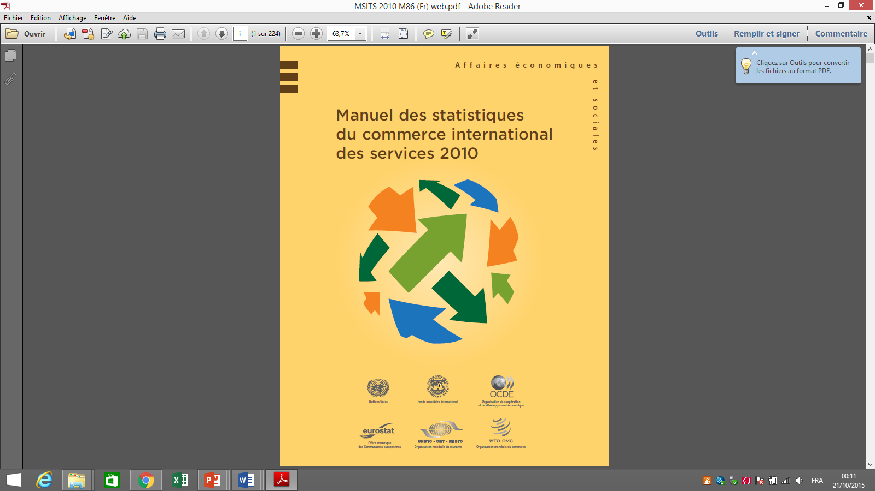

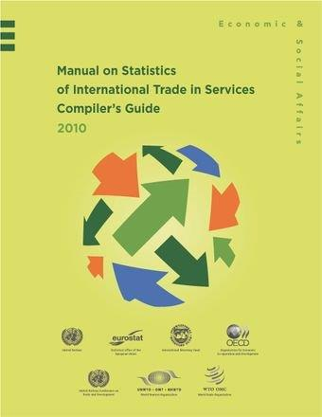
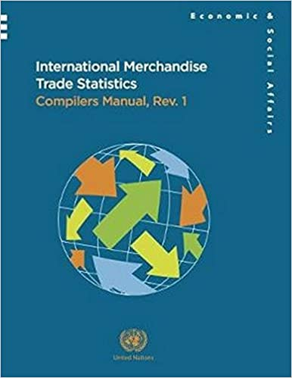
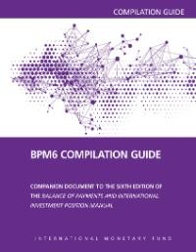
Manuals on international trade statistics

Slide 3
Background
Task Team on International Trade Statistics
UN Committee of Experts on Business and Trade Statistics
Established in 2021:
First meeting in October 2021
Monthly meetings
Priorities:
Revising the international trade statistics manuals
Integration between trade and business statistics
Cross-cutting topics (e.g., GVC, digital trade)
Leadership, broad representation:
TT-ITS is led by Morocco and Portugal
Worldwide representations
Capacity-building (maturity model, trade data tools)
3

Slide 4
Research Agenda: Vertical and Horizontal integration
Vertical integration
Upstream harmonization of ITS with macroeconomic statistical frameworks, including BPM and SNA
Downstream integration with the various data sources, including customs, administrative and survey data
Horizontal integration
Globalization
Digitalization
Well-being
Sustainability
4

Slide 5
Keeping stakeholders updated
Key reports and documents to the UN Statistical Commission:
Business and trade statistics
2021 - the launch of the revision process (at the 52nd Session of the UN Statistical Commission)
2022 - the research agenda and terms of reference
2023 - the development of the handbook on integrating business and trade statistics and progress update
Global consultations
2023 - Consolidated proposed updates/clarifications in May 2023 global consultations
(https://unstats.un.org/wiki/x/XoAGD)
2024 - Further proposed updates/clarifications in February 2024 global consultations
5

Slide 6
Research Agenda: Vertical
v.1 Scope of IMTS and SITS
v.2 Impact of the BPM updates
v.3 Bilateral trade asymmetry (goods and services)*
v.4 Informal Cross Border Trade (Goods And Services)
v.5 Recording Principle – Change Of Ownership Instead Of Cross-Border For Selected Commodities (Goods)
v.6 Trade System – Improved Coverage By Implementing General Trade System Exclusively (Goods)
v.7 Valuation – Utilizing Invoice Value In Addition To CIF, FOB (Goods)
v.8 Price And Volume Measurement (Goods And Services)
v.9 Factoryless Goods Producers And Merchanting (Goods)
v.10 Measurement Of Modes Of Supply (Services)*
v.11 SITS Classifications EBOPS (Services)
v.12 Trade Flow, Nature Of Transactions And Customs Procedure Codes (Goods)
v.13 Valuation on specific transactions/products (Goods and Services)**
v.14 Alternative data sources – high-frequency data sources (Goods and Services)
V.15 Upgrading SDMX-IMTS to Technical Specification version 3.0 (Goods)
v.16 Clarification on Cultural Products Resulting From Creative Industries (Goods and Services)
v.17 Revision of the Standard International Trade Classification (SITC) (Goods)
v.18 Indicators on Trade Statistics (Goods and Services)
Guidance Notes in the first global consultation
Guidance Notes in the second global consultation (* for information)
Dedicated manual

Slide 7
Research Agenda: Horizontal
h.1 Digital Trade Including Conceptual Framework, Price And Volume Measurement (Goods And Services)
h.2 Global Value Chains (Goods And Services)
h.3 Linking Trade and Business Statistics (Goods And Services)
h.4 Impact of Trade on Environment and Sustainability (Goods And Services)*
h.5 Impact Of Trade On Well-Bering, Labor, Gender And Productivity (Goods And Services)
h.6 Foreign Affiliates Statistics (FATS) (Goods And Services)
h.7 Classification: BEC Rev.5, Business Functions (Goods And Services)*
h.8 Impact Of ISIC And CPC Revisions (Goods And Services)*
Guidance Notes in the first global consultation
Guidance Notes in the second global consultation
Dedicated handbook

Slide 8
Topics for 2nd global consultation
[Topic #1: Scope of IMTS, inclusion of goods
crossing the border illegally]
[Topic #2: Amended scope of Informal
Cross-Border Trade (ICBT)]
[Topic #3: Global production arrangement,
including FGPs and nature of
transaction and customs procedure codes]
[Topic #4: Trade System]
[Topic #5: SDMX for trade statistics]
[Topic #6: National practice assessment on
integrating business and trade statistics]
[Topic #7: National practice assessment on the
valuation of long-term contracts]
Additional items for information
Topic |  | Related GN
1 | Bilateral asymmetries | GNV.3
2 | Measurement of Modes of Supply | GNV.10
3 | Impact of trade on the environment and sustainability | GNH.4
4 | Impact of ISIC and CPC Revisions | GNH.8
5 | Use of alternative data sources | GNV.14
6 | Price and Volume Measurement | GNV.8
7 | Classification: BEC Rev.5 and Business Functions | GNH.7
8 | Treatment of coins of legal tenders from precious metals | GNV.13b
8

Slide 9
[Topic #1: Scope of IMTS, inclusion of goods crossing the border illegally]
Recall: IMTS 2010 recommends exclusion of Goods entering or leaving the economic territory of a country illegally (para 1.59).
The general recording principle of IMTS requires that all goods which add to or subtract from the stock of material resources of a country by entering (imports) or leaving (exports) its economic territory should be recorded.
V.4b considers the treatment of non-observed trade which includes, among others, trade in illegal goods and services, and trade in goods otherwise legal but entering or leaving the economic territory of a country illegally and services otherwise legal but provided or acquired illegally.
Recommend expanding scope of IMTS and ICBT.
9

Slide 10
[Topic #1: Scope of IMTS, inclusion of goods crossing the border illegally]
 | Current IMTS | 1st Proposal ICBT | Proposal IMTS | Amended Proposal ICBT
Legal goods | Include | Include if conducted by informal units | Include | Include if conducted by informal units
Illegal goods | Exclude | Exclude | Include | Exclude
Legal movement | Include | Include if conducted by informal units | Include | Include if conducted by informal units
Illegal movement | Exclude | Exclude | Include | Include if conducted by informal units
De minimis | Include if significant | Include if conducted by informal units | Include if significant | Include if conducted by informal units
Shuttle Trade | Include if significant | Include if conducted by informal units | Include if significant | Include if conducted by informal units
10

Slide 11
Amended scope of Informal Cross-Border Trade (ICBT)
GNV.4a is an amended GNV.4 which defines the ICBT both in IMTS and MSITS
To be consistent with country best practices and the informal economy conceptual framework
(IE.1 of SNA update)
GNV.4a is addressing the issues identified in the first global consultation
(include smuggling; products illegal in one country and not another) and GNV.4b
11

Slide 12
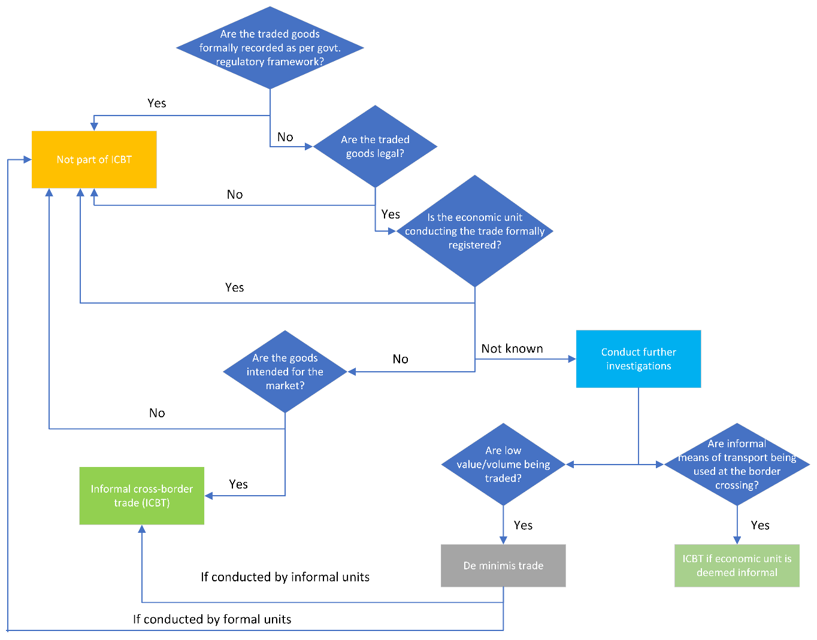
Decision tree for classifying informal cross-border trade in goods in IMTS
12

Slide 13
[Topic #2: Global production arrangement, including Factoryless Goods Producers (FGPs) and nature of transaction and customs procedure codes]
One of the features of globalization is that manufacturers and service providers have adopted a variety of new arrangements which fragment the production process across different companies and countries.
GNV.9 deals with the recording of transactions related to global production arrangements.
Explores whether IMTS can be a source of information on factoryless goods producer set-ups and on the valuation of the related goods.
Proposes that IMTS compilers in the countries of the principal, the contractor and the final customer should be encouraged to identify transactions related to global production arrangements whenever possible, potentially through nature of transaction codes.
13

Slide 14
[Topic #2: Global production arrangement, including Factoryless Goods Producers (FGPs) and nature of transaction and customs procedure codes]
GNV.12 considers customs procedure codes (CPCs)
and the nature of transaction codes (NoT codes) in IMTS.
Value of CPCs and nature of transaction codes as tools for
including/excluding transactions in IMTS.
Possibility of publishing information derived from CPCs and NoT codes,
thereby increasing the value of the statistics for users.
Proposes encouraging improved data items for publication.
- stand-alone statistical output codes (CPC x NoT).
14

Slide 15
[Topic #3: Trade System]
IMTS 2010 recommends the use of the general trade system but recognizes
the special trade system as well.
Analyses by the task team found that when the relaxed definition is used, discrepancy with data compiled on a general trade system basis is marginal.
GNV.6 includes the following main recommendations
- general trade system,
- relaxed definition of the special trade system
strict definition of the special trade system only as a last resort
- If the special trade system is used, compile or estimate, at least on an annual and a quarterly basis,
with full geographical and commodity breakdowns (unless such trade is insignificant), statistics on
goods imported into and exported from: premises for customs warehousing; premises for inward
processing; industrial free zones or commercial free zones.
15

Slide 16
[Topic #4: SDMX for trade statistics]
The variation in data and metadata across countries, regions, and international organizations can lead to challenges in reporting and comparing trade data.
SDMX (Statistical Data and Metadata eXchange) is an ISO standard designed to describe statistical data and metadata, normalize their exchange, and improve efficiency in sharing.
GNV.15 describes the conceptual and basic technical elements
- upgrading of SDMX-IMTS to updated standards
- new data elements (V.7 and V.12)
- implementation
- consideration of SDMX-SITS
16

Slide 17
[Topic #5: National practices assessment on integrating business and trade statistics ]
TT-ITS is working on the Handbook on Integrating Business and Trade Statistics (HIBTS)
More details in the third part of the presentation
Aim of this consultation is to get country practices and experiences
17

Slide 18
[Topic #6: National practice assessment on the valuation of long-term contracts]
BOPCOM 15/17 notes that “...the Production of bulk commodities usually requires significant upfront capital.
Long-term contracts in trade, with either fixed or index-linked prices
No change in BPM update
GNV.13a does not propose any changes
There is interest in the topic for further understanding:
- data and information on long-term contracts;
- whether transferable or tradeable, would improve analysis and understanding in the future
- hope that countries can conduct further research into the use of long-term contracts as
a hedge against risks
18

Slide 19
How can you contribute?
Feedback during global consultation.
Country practices.
Contributors or reviewers of specific section/chapters.
19

Slide 20
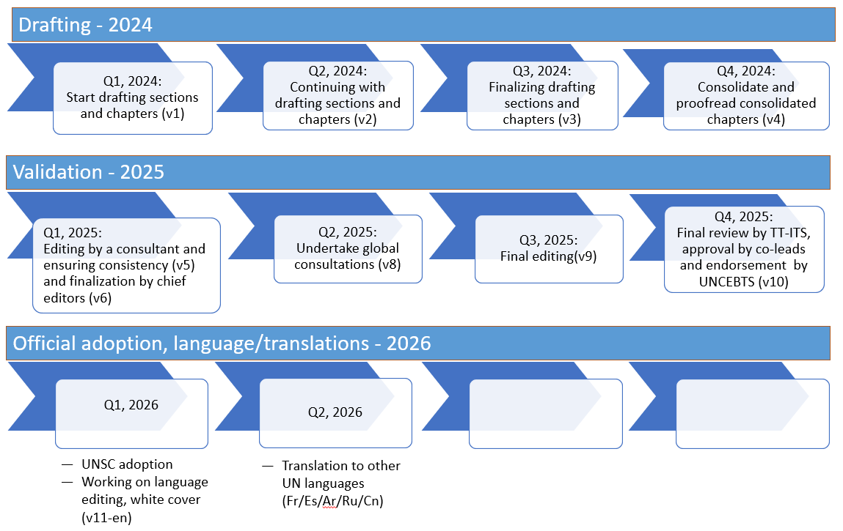
General Timeline – of IMTS and MSITS update
20

Slide 21
Progress update on the revision of IMTS 2010
Meeting of the Task Team on International Trade Statistics
March 27, 2024

Slide 22
IMTS revision – guiding principles, status
Chief editors (ABS) and various cluster/chapter leads
Lean manual focusing on concepts (to the extent possible)
Common approach/chapters with the MSITS and HIBTS
Contributors working on Version 1 (draft text and sections)
Notes:
Look at concepts with a compiler’s eye (Diana): are they applicable in all circumstances (e.g. digital presence vs residency)
Note down compilation issues as we work on the concepts (Andrea) to facilitate CG

Slide 23
Progress update on the revision of MSITS 2010
Chief editors (OECD and WTO) and various chapter leads
Meeting of the Task Team on International Trade Statistics
March 27, 2024

Slide 24
MSITS revision – guiding principles
MSITS should build on and be consistent with BPM7, but also bring users/compilers additional value
Provide a holistic view on trade in services, encompassing different statistical frameworks (BPM and FATS) and different dimensions/perspectives
  How trade takes place (modes of supply, digital trade)
  Who trades (STEC, gender dimension…)
  What is traded (with additional granularity/focus on important aspects such as environment…)
  ‘thin’ manual: minimize repetitions, concepts only (to the extent possible)
    however, we want to ‘look at concepts with a compiler’s eye’
Scope of manual beyond trade in the strictest sense
  Some mixed views on changing the title (one possibility: Manual on Statistics of International Supply of Services) – at the moment we stick to current title
Notes:
Look at concepts with a compiler’s eye (Diana): are they applicable in all circumstances (e.g. digital presence vs residency)
Note down compilation issues as we work on the concepts (Andrea) to facilitate CG

Slide 25
Suggested broad outline of new MSITS
Introduction
  Short and general text to explain the rationale for the revision, structure of the new manual, summary of main recommendations
A conceptual framework for measuring the international supply of services
  The first part of the chapter will be common with IMTS (basic concepts and definitions, boundaries between goods and services…)
  The second part will present the conceptual framework for measuring trade in services in the broadest sense (meaning all the statistical frameworks and dimensions needed to provide a holistic picture of trade in services) – similar diagram to what we have for digital trade

Slide 26
Suggested broad outline of new MSITS
Services transactions between residents and non-residents
  same scope as the BPM7 chapter on services, avoiding too many repetitions but still providing all the basic information to readers. Issues not well covered by BPM7 can be explored and clarified.
International supply of services through commercial presence
  Revamping/shortening of current chapter IV, focus on local supply (not on FATS in general). Substantial re-drafting is needed to focus on what is needed exactly to measure commercial presence and how to avoid overlapping between ITS and FATS data.

Slide 27
Suggested broad outline of new MSITS
Towards a holistic measure of trade in services
  This chapter should develop the additional dimensions covered by the conceptual framework:
    Modes of Supply
    STEC
    Digital trade in services
    Additional dimensions…

Slide 28
Suggested broad outline of new MSITS
Quantitative indicators on the international supply of services
  This new chapter would contain material from current ch V section D, covering mode 3 and mode 4 quantitative indicators plus possibly volume/price measures of services trade
Data quality and dissemination
  Quality assurance framework
  Data dissemination (confidentiality, revisions, seasonal adjustment…)
  Text to be consistent with HIBTS and IMTS

Slide 29
Annexes
Annex 1 (new): Statistical systems and classifications related to trade in services
  Roughly corresponds to current ch II, section C, updated with SNA 2025, BPM7, BD5…
Annex 2: 2026 EBOPS (to be developed)
  The relevant content will be carried over from MSITS 2010 and GNV.11 on EBOPS update with some editing for consistency.
Annex 3: ISIC rev.5 Categories for Foreign Affiliates in services (ICFA, rev. 2)
  ICFA rev 2 to be developed following new ISIC rev. 5
Annex 4: extract from GATS
  No changes envisaged
Annex 5: Services sectoral classification list (W/120)
  No changes envisaged
Annex 6: Relationships between MSITS 2026 and IRTS 2008
  Not many changes envisaged buy needs review by UN Tourism

Slide 30
Where do we stand?
We envisage substantial changes in structure compared to MSITS 2010
  Two parallel workstreams ongoing
Finalization of EBOPS 2026
Coordination with IMTS and HIBTS leads on common issues
Aim to have first draft of 4-5 chapters in time for Ankara meeting
Refine the AO and clarify boundaries of chapters 2, 5 and 6
Develop the conceptual framework
Start drafting of ‘core’ chapters (BoP, commercial presence, MoS) as priority

Slide 31
Current TT GN related to services
v.1 Scope of IMTS and SITS => introduction, conceptual framework
v.2 Impact of the BPM updates => introduction, conceptual framework
v.3 Bilateral trade asymmetry (goods and services) => not sure relevant for manual (CG), but some hints
v.4 Informal Cross Border Trade (Goods And Services) => conceptual framework (scope)
v.8 Price And Volume Measurement (Goods And Services) => new ch 6
v.10 Measurement Of Modes Of Supply (Services) => conceptual framework, chapter 5
v.16 Clarification On Cultural Products Resulting From Creative Industries => EBOPS complementary grouping?
v.18 Indicators on Trade Statistics (Goods and Services) => ?

Slide 32
Current TT GN related to services
h.1 Digital Trade Including Conceptual Framework, Price And Volume Measurement (Goods And Services) => mention in ch 2, then annex?
h.2 Global Value Chains (Goods And Services)=> not sure relevant
h.3 Linking Trade And Business Statistics (Goods And Services) => ch 6
h.4 Impact Of Trade On Environment And Sustainability (Goods And Services)=> ch 6?
h.5 Impact Of Trade On Well-Being, Labor, And Productivity (Goods And Services) => ch 6?
h.6 Foreign Affiliates Statistics (FATS) (Goods And Services) => ch 4
h.7 Classification: BEC Rev.5, Business Functions (Goods And Services) => annexes on classifications
h.8 Impact of ISIC And CPC Revisions (Goods And Services)=>annexes on classifications, ICFA

Slide 33



Handbook on Integrating Business and Trade Statistics (HIBTS)
Progress report of the 3rd editing round
Task Team on International Trade Statistics
UN Committee of Experts on Business and Trade Statistics
March 27th, 2024

Slide 34
Context
The HIBTS is currently finalizing the third editing round process. March 8, 2024, was the deadline for receiving updates for each chapter, incorporating elements from the discussions that contributors and reviewers shared during the specific meetings; also, it was the deadline for collecting country experiences using the template provided by UNSD
The Chief Editors of HIBTS have organized two meetings with counterparts responsible for drafting the IMTS and MSITS. The purpose was to discuss addressing cross-cutting issues such as confidentiality and quality, in order to maintain consistency across the three documents
The integrated version of HIBTS from the third editing round was circulated among the leaders of the Task Teams on Statistical Business Registers (TT-SBR) and the Task Team on Business Dynamics, Demography and Entrepreneurship (TT-BDDE)

Slide 35
Objective
In the following slides, we will inform on:
  The progress report of HIBTS
  The updated timeline for 2024 and the expected deliverable that will be shared to the UNSC
  The following steps before the next TT-ITS hybrid meeting in June
  Additionally, it will be discussed the strategy for developing a public repository of practices related to business and trade statistics

Slide 36
Outline of HIBTS: Chapters and sections
HIBTS working outline
1. Introduction | 1.1. Motivations and policy relevance 1.2. Scope and objectives
2. Data Sources, their conceptual framework and potentials for data linking | 2.1. Statistical Business Register 2.2. Business statistics 2.3. International trade statistics 2.4. Other useful data sources 2.5. Institutional environment and statistical preconditions
3. Microdata linking methods | 3.1. Data linking
4. Linking business and trade in goods statistics | 4.1. Process for linking business and trade in goods statistics
5. Linking business and trade in services statistics | 5.1. Process for linking business and trade in services statistics
6. Quality and comparability | 6.1. Quality dimensions and proposed quality indicators 6.2. Scope and comparability between linking business with trade in goods and services
7. Dissemination | 7.1. Confidentiality dimensions in the disseminated data 7.2. Data and metadata dissemination for TEC 7.3. Data and metadata dissemination for STEC
8. Innovation on linking business and trade statistics | 8.1. Integrating gender in business and trade statistics 8.2. New opportunities for the measurement of the digital economy and globalization 8.3. Extensions to Balance of Payment statistics 8.4. Linking to social statistics 8.5. Subnational statistics 8.6. Expanding the indicators related to linking trade and business statistics (pending) 8.7. Issues related to linking trade in goods statistics with trade in services statistics 8.8. Other relevant analysis

Slide 37
Confidentiality in HIBTS
In HIBTS, it is envisaged to provide a full narrative (in a holistic perspective) of confidentiality in the process of integrating business and trade statistics
Access to microdata and sharing of information
Integrating and processing the data
Dissemination and Quality of the data
Legal framework (Centralized and decentralized systems; National laws)
Institutional and collaborative Arrangements (MoUs, data sharing at national and international levels)
Integrating information when some of the sources present are not available due to confidential restrictions
Active and passive confidentiality in the disseminated data
Microdata access to users

Slide 38
Quality in HIBTS
During the specific meetings to discuss the topic of quality in HIBTS, it was recommended to present a general overview of quality by considering the UN NQAF Manual 2019
However, it is not suggested to be exhaustive in the description of quality but supports countries on the key elements that should be considered for producing linked business and trade statistics
Moreover, it is recommended to follow the Generic Statistical Business Process Model as a key element for producing consistent and quality statistical information, as well as for facilitating international comparisons

Slide 39
Outcomes from the meetings with the IMTS and MSITS Chief Editors
One element that should be considered is the different nature of the manuals. While IMTS and MSITS are conceptual, HIBTS addresses conceptual, methodological and practical issues
Chief Editors from IMTS suggested to coordinate with the aim to use the same language across the manuals
Chief Editors on HIBTS, IMTS and MSITS agreed to continue the communication and share any updates on the treatment and content of Comparability and Quality
Once the updated version of HIBTS is available, the HIBTS team agreed to share the document with the IMTS and MSITS to receive feedback.

Slide 40




Timeline of HIBTS for 2024
Fourth editing round (TT-SBR and TT-BDBDE review) | March 8th | Deadline to receive the country experiences by using the suggested template. Deadline for the contributors to update the chapters based on the specific meetings
 | March 21st – April 8th | Chief editors will circulate the revised draft to the TT-SBR and the TT-BDBDE members to collect inputs from the business side
 | Late-April (date to be defined) | Organizational meeting with HIBTS members to present the integration of comments from the 2nd TT-ITS Global Consultation and the TT-SBR as well as TT-BDBDE
 | April 9th – May 3rd | Contributors will update the document based on the input received from the TT-SBR and TT-BDBDE
 | May 6th – June 7th | Revision round by chief editors and reviewers and preparation of the Questionnaire and related documents for the Global Consultation of HIBTS
Preparation of the Global Consultation of HIBTS | 10th – 14th June | Presentation of the progress during the TT-ITS hybrid meeting and endorsement of HIBTS by the TT-ITS members
 | 18th – 29th June | Comments from the TT-ITS to the questionnaire for the global consultation of HIBTS
 | 2nd – 13th July | Finalization of the questionnaire and related documents for the global consultation
 | July 22nd – August 23rd | Review and endorsement by the UNCEBTS Bureau of the draft document and the questionnaire for the global consultation
 | September 9th - October 4th | Global Consultation of HIBTS
 | October 7th - 18th | UNSD will process the responses and share them with the Chief Editors
Preparation of the Final draft for its presentation to the UNSC | October 21st - November 15th | Update the document based on the comments received from the Global consultation (contributors and reviewers) and final revision by chief editors
 | November 18th -29th | Editorial revision by the UNSD secretariat Preparation of the background document on HIBTS for the UNSC
 | December 2024 | Review and endorsement of the HIBTS by the UNCEBTS Bureau
 | Early 2025 | Send the White Cover version of HIBTS to the UNSC Secretariat

Slide 41
Initiative to elaborate a public repository on business and trade statistics practices
Building on the public site of the Country Progress Report of the Wiesbaden Group on Business Registers, Chief Editors propose creating an online repository of practices related to business and trade statistics
This repository will allow countries to upload their experiences for inclusion in HIBTS, making them accessible for consultation and supporting the sharing of knowledge
Additionally, during the second global consultation of TT-ITS and the dedicated Global Consultation of HIBTS, more experiences are expected to be collected
The next slide presents a proposal for organizing the information by country and thematically using tags
1: https://unstats.un.org/wiesbadengroup/cpr

Slide 42

Initiative to elaborate a public repository on business and trade statistics practices
United Nations >> Department of Economic and Social Affairs >> Statistics Division >> Integrating Business and Trade Statistics
Topic
Year
Country/International Organization
Extract
Please select /search
All x
Country 1
Country 2
Please select/search
TEC
Probabilistic linkage
Social Statistics
Topics
STEC
Gender
National Accounts
MDL
Subnational Statistics
etc...

Slide 43
Agreements and next steps
The contributors and Chief editors are now analyzing the inputs from the business experts (TT-SBR and TT on BDDE) of the UNCEBTS.
In April, a coordination meeting is expected to be organized with contributors and reviewers to discuss the contributions from the business experts of UNCEBTS and from the 2nd global consultation.
A revised version (of the 4th editing round) is expected to be available before the hybrid meeting of the TT-ITS (June 10-14, 2024)
This version will serve as the basis for developing the questionnaire and other related materials for the dedicated Global Consultation on HIBTS.

Slide 44

Manual on Principal Indicators for Business and Trade Statistics
Chief editors (Office des Changes, Morocco and UNCTAD)
Markie Muryawan & Habib Khan
United Nations Statistics Division
Notes:
44

Slide 45
Background and rationale
The UN Statistical Commission (53rd session, 2022) took note of Volume 1 of the Manual on the Principal Indicators on Business and Trade Statistics (HIBTS) and encouraged the preparation of Volume 2 of the manual to further elaborate on the international trade indicators.
Data produced by compilers of international trade statistics are considered by users to be raw data.
The development of indicators of external trade in goods and services constitutes a dynamic presentation of these data.
The objective is to make the data more meaningful and more understandable for users, in particular, policy makers.

Slide 46
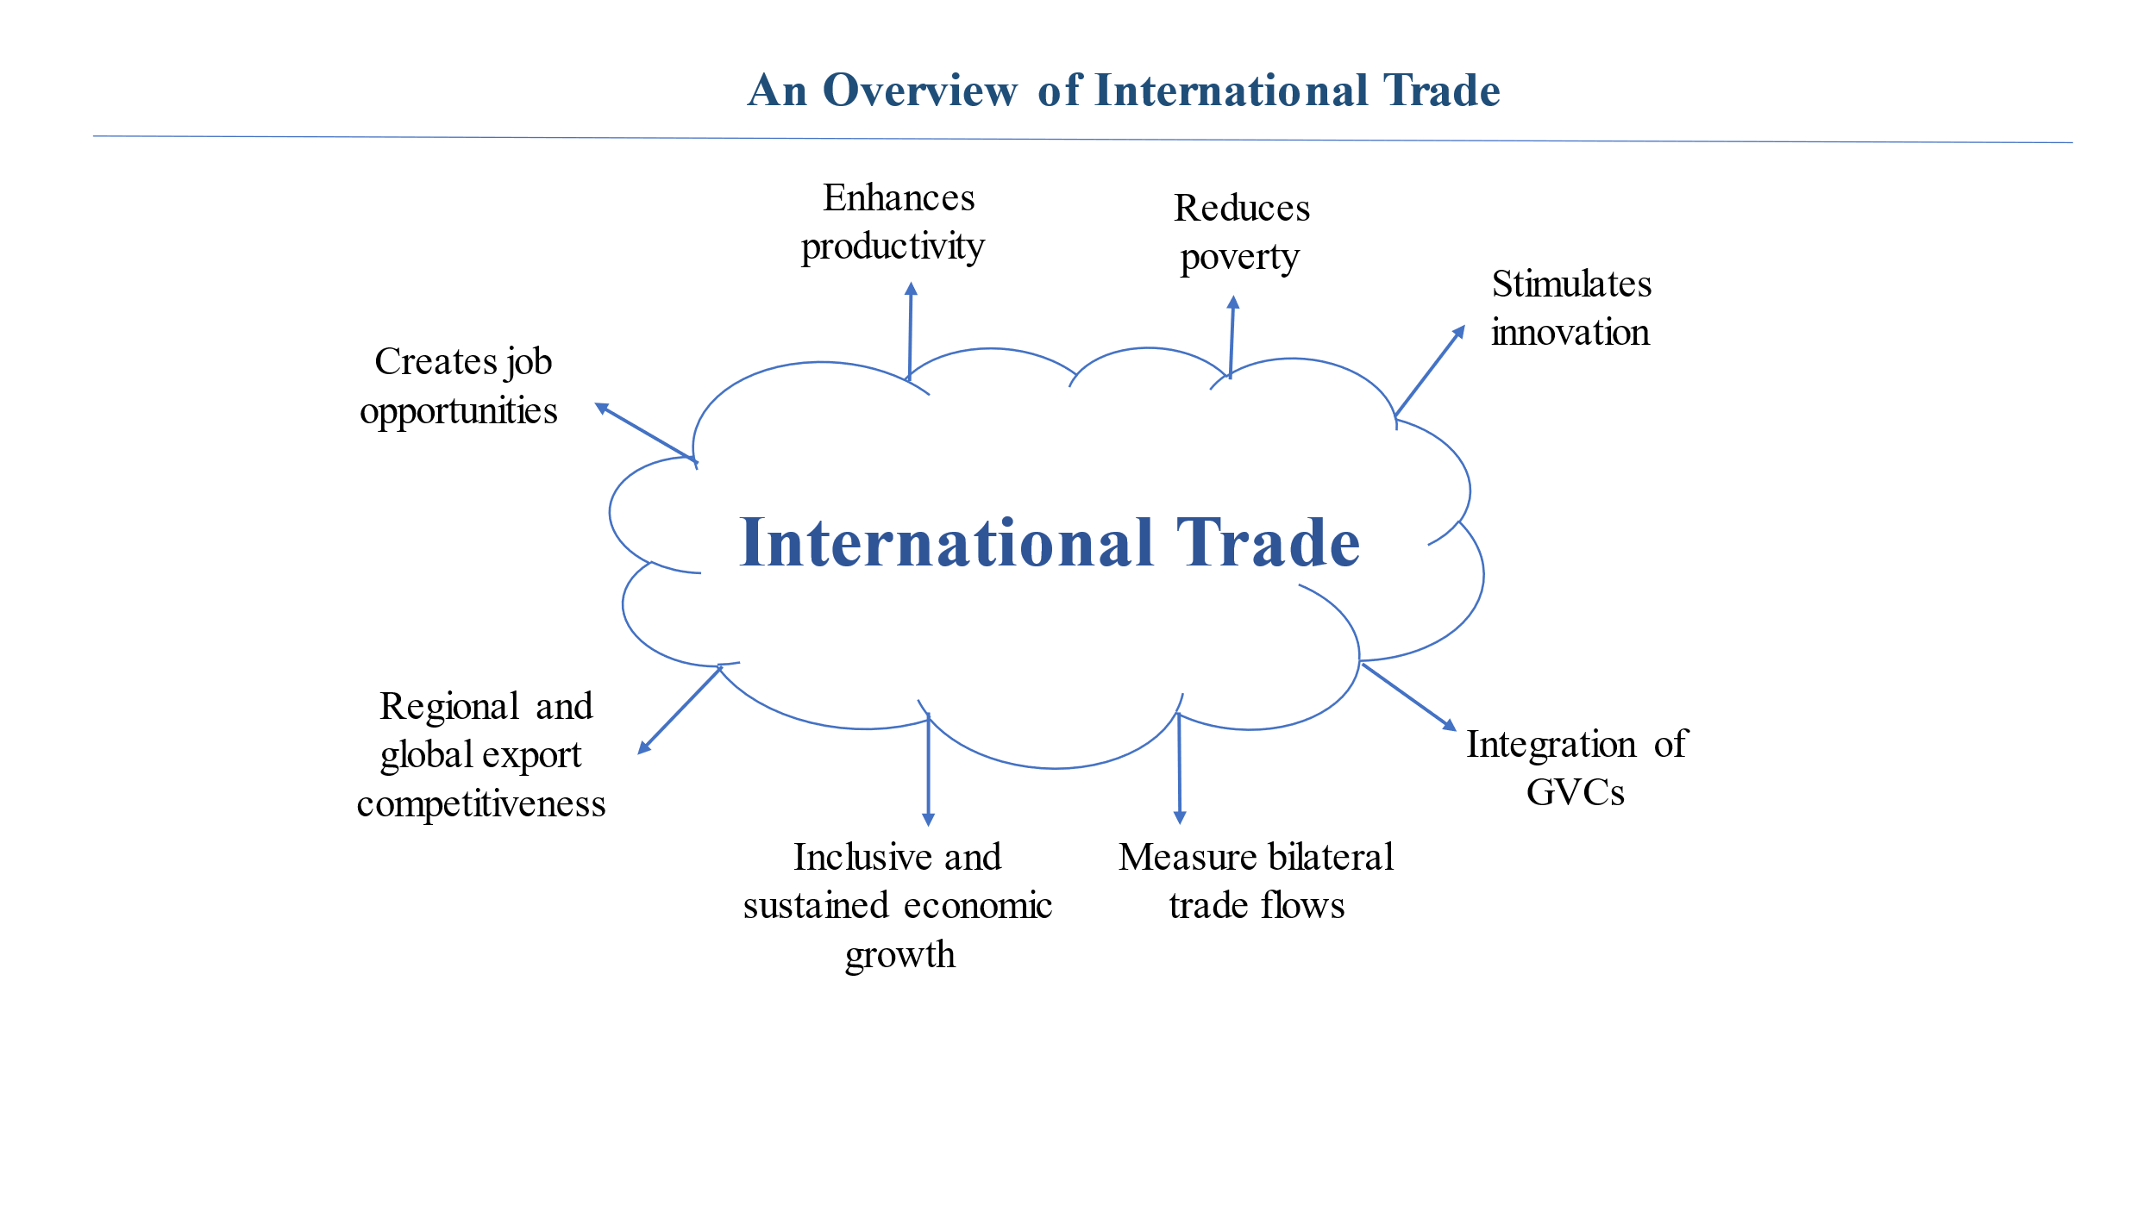
Use of trade data
Use of trade data
Statistics on trade in goods and services are used by policy makers to:
  Formulate economic policies;
  Assess degree of integration of national economy into the global economy;
  Monitor national and international economic situation;
  Study external balances with a view to formulate policy to correct imbalances;
  Make projections;
  Develop/monitor Free Trade Agreements;.

Slide 47
Goals and outputs
Goals
Meet policy needs ​including impact on trade on other domains (e.g. gender, wellbeing, environment);
Easier and better reading of foreign trade data.​
Expected key outputs
Identification of a set of principal indicators for recommendation to countries;
Interpretation, methodology and metadata for the proposed principal indicators;
Detailed country practices and compilation guide (print and web, live version).

Slide 48
Draft structure: outline
Chapter | Questions to be addressed
1. Introduction
2. Role of international trade statistics | What can international trade statistics contribute? Which questions and problems can it help to solve? Which are its limitations? Which are its specific constraints and resources? How is international trade statistics connected with other domains?
3. Core indicators | Which are recommended indicators that can be constructed from (classical) international trade statistics alone?
4. Aspirational (cross-cutting) indicators | How can international trade statistics benefit from closer integration with other domains? Which recommended indicators can be constructed based on that integration?
Annex: indicator sheets

Slide 49
Draft structure: annotated
Draft structure: annotated
1. Introduction
  A. Background
  B. Structure of the manual
  C. Process of preparing the manual
  D. Target audience
2. Role of international trade statistics
  A. Purposes and uses
  B. Conceptual aspects
  C. Data environment and compilation frameworks
3. Core indicators
  A. Introducing the thematic areas
  B. Trade and the national economy (area 1)
  C. Trade structure (area 2)
  D. Regional integration and Global Value Chains (area 3)
4. Aspirational indicators / integrating trade statistics with other domains
  Business statistics
  Social statistics / gender/ wellbeing
  Environmental statistics, blue economy
  Transport statistics
  ICT and e-commerce
  Tourism statistics
Annex: Indicator sheets

Slide 50
More details on chapter 2
2. Role of international trade statistics
Main questions: How can international trade statistics be used to inform policies? What are its limitations? How is it connected to other domains?
2.A. Purposes and uses
Understanding a country’s role in the global economy
Understanding the role of trade in a country’s economy
Monitoring of external balances
Preparation of free trade agreements

Slide 51
Handbook/Guidelines
More details on chapter 2
2. Role of international trade statistics
2.B. Conceptual aspects
Focus on territories (usually countries) or their resident populations as units of analysis
Relation with other domains, such as national accounts and BOP
2.C. Data environment and compilation frameworks
Well-established data collections in place, based on customs records, ITRS, enterprise surveys, …
Availability of mirror data for cross-validation and filling of data gaps
Involvement of different national agencies in data compilation
Benefits from cooperation between countries (to solve asymmetries)
Emerging data sources (e.g., vessel tracking, digital trade)
Main data quality challenges

Slide 52
Handbook/Guidelines
More details on chapter 3
3. Core indicators
Main question: Which are recommendable indicators that can be constructed from (classical) international trade statistics alone?
3.A. Introducing the three thematic areas
3.B. Area 1: Trade and the national economy
3.C. Area 2: Trade structure
3.D. Area 3: Regional integration and Global Value Chains

Slide 53
Handbook/Guidelines
More details on chapter 3
Trade balance
Foreign trade coverage ratio
Trade balance in goods and services as a percentage of GDP
Trade to GDP ratio
Export propensity
Import penetration ratio
Trade per capita
Trade share
Market share
Terms of trade
Herfindahl index of geographical concentration
Hirschman-Herfindahl Index
Export Diversification (or Concentration) Index
Export Product Concentration Index
Import Product Concentration Index
THEIL Index
Revealed Comparative Advantage
Export Specialization Index
Intra-industry trade by sector (Grubel-Lloyd Index)
Trade Intensity Index
Trade Complementarity Index
Export Market Concentration Index
Import Market Concentration Index
Intra-regional trade intensity index
First list of indicators

Slide 54
Handbook/Guidelines
More details on chapter 4
4. Aspirational indicators / integrating trade statistics with other domains
Main question: How can international trade statistics benefit from closer integration with other domains? Which recommendable indicators can be constructed based on that integration?
Business Statistics
Social statistics/wellbeing
Well-being and gender indicators
Environmental statistics, blue economy
Transport statistics
ICT and e-commerce
Tourism statistics

Slide 55
Handbook/Guidelines
More details on annexes
Annexes:
Indicator sheets
Other considerations:
Elements to be included throughout the book (e.g., using boxes):
Country experiences
Illustrations of application cases

Slide 56
Status and way forward
Progress and key decisions:
Draft outline of the Manual finalized;
Next steps and timeline
Review of aspirational indicators (chapter-4);
First draft by June 2024;
Global consultation in July 2024 (subject to needs for coordinating with HIBTS);
Final draft by September/October 2024.
Core indicators (chapter-3) and their thematic areas reviewed and revised;
Contributors for drafting identified.
Drafting of different chapters and sections

Slide 57
Indicator sheet template
 | Metadata
Name of the indicator
Definition:
Mathematical formula:
Economic interpretation:
Data sources:
Associated classifications:

Slide 58
Thank you

