Slide 1
Official European Statistics on Trade by Enterprise Characteristics (TEC)
JOINT GCC-STAT/UNSD WORKSHOP ON FUTURE OF
INTERNATIONAL MERCHANDISE TRADE STATISTICS
9-11 November 2020
Valdone Kasperiuniene Eurostat

Slide 2
Content
Introduction
Prerequisites for TEC compilation
TEC compilation in EU
  Data sets
  Methodology and data transmission rules
  Quality work
  Dissemination
    Future developments

Slide 3
Introduction
Trade by enterprise characteristics (TEC) aims at bridging two statistical domains – international trade in goods and business statistics - which traditionally have been compiled and used separately
TEC connects two different methodological approaches applied in trade in goods and in business statistics
TEC quality depends on the quality of the source datasets (trade in goods statistics and business register data)
TEC is compiled by micro-data linking
TEC does not require additional data collection

Slide 4
Prerequisites for compiling TEC
The National Statistical Office should collect trade data at trader level (trader ID)
Good quality Statistical Business Register (SBR) which enables to link traders’ ID with the statistical ID contained in the register
Close cooperation between trade and business statisticians

Slide 5
Methodological differences between trade and business statistics affecting TEC compilation
Trade statistics
Business statistics
Statistical unit – trader
Passive confidentiality
Reference period – monthly
Statistical unit - enterprise
Active confidentiality
SBR updated annually

Slide 6
Business Register variables used for TEC compilation (for enterprise)
Principal activity code (NACE 4 digit)
Number of persons employed (for grouping enterprises in to size classes)
Turnover (annual; for calculation of exports intensity)
Ownership and controls characteristics:
  it indicates whether an enterprise is domestically or foreign controlled, and
  if it is domestically controlled, whether it has affiliates abroad or not

Slide 7
TEC compilation in EU
TEC - well established statistical area
  First pilot projects of linking trade in goods and BR data started in 2003
  Gradual development of definitions, methodology, quality requirements and IT tools
  Legal obligation introduced by European regulations in 2009/2010
  Annual publication of official statistics in September-October

Slide 8
Compiled data sets
TEC data are compiled annually - 6 mandatory and 4 optional data sets:
  mandatory breakdowns - by NACE, traders size class, concentration of trade, CPA and type of traders (provided by 27 Member States)
  optional data – type of ownership, exports intensity, NACE 4, partner country in combination with traders size class, (provided by 16 Member States)
  In addition, all Member States provide quality indicators on data matching

Slide 9

Development of methodology and transmission rules
  All EU Member States implemented SDMX-ML format for transmission of data to Eurostat
  Eurostat developed code lists specific for TEC data, which can be reused by other organizations compiling statistics on TEC
  The Trade by Enterprise Characteristics DSD is
  available on Euro SDMX Registry
  The compilation methodology and the data
  validation rules were developed and published
  in the Compilers guide on European statistics on
  International trade in goods by enterprise
  characteristics

Slide 10
TEC DSD Overview
CONCEPT ID | CONCEPT NAME | Code list or format | Agency
FREQ | Frequency | CL_SDMX_FREQ | SDMX
REPORTING_COUNTRY | Reporting country | CL_GEO_EUCCEFTA | ESTAT
PARTNER | Partner | CL_TEC_COUNTRY_TRADE | ESTAT
NACE_REV2 | Economic activity | CL_TEC_ACTIVITY | ESTAT
NB_EMPLOYEE | Number of employee | CL_TEC_NB_EMPLOYEE | ESTAT
NB_ENTERPRISE | Number of enterprise | CL_TEC_NB_ENTERPRISE | ESTAT
NB_PARTNER | Number of partner countries | CL_TEC_NB_PARTNER | ESTAT
CPA | Commodity | CL_TEC_CPA | ESTAT
TRADE_POPULATION | Trade population | CL_TEC_TRADE_POPULATION | ESTAT
TEC_FLOW | Flow | CL_FLOW | ESTAT
TYPE_OF_CONTROL | Type of control | CL_TEC_TYPE_CONTROL | ESTAT
TYPE_OF_TRADER | Type of trader | CL_TEC_TYPE_TRADER | ESTAT
… | … | … | …
EXPORTS_INTENSITY | Exports intensity | CL_TEC_EXPORTS_INTENSITY | ESTAT
OBS_STATUS | Observation status | CL_SDMX_OBS_STATUS | SDMX
CONF_STATUS | Confidentiality flag | CL_SDMX_CONF_OBS | SDMX
TABLE_ID | Table identification | CL_TEC_TABLEID | ESTAT

Slide 11
Data validation
  Rules described in TEC Compilers Guide
  Developed validation tool which is used by Member States to validate data sets before transmission to Eurostat
  Transmission of data to Eurostat and validation:
  Level 1- Intra-dataset checks
  Level 2- Inter-dataset checks
  Level 3- Intra-domain checks

Slide 12
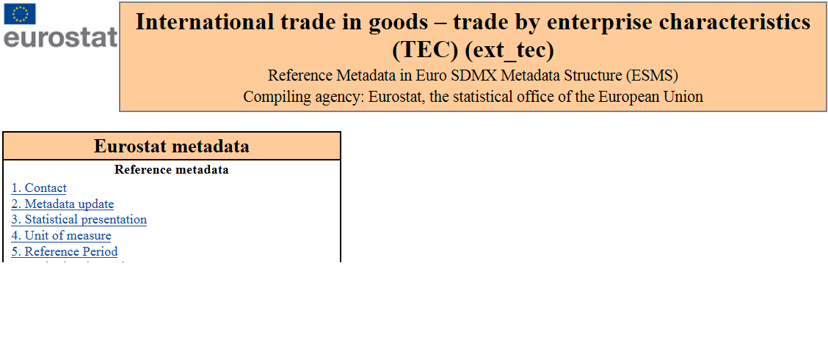
Quality work
  Established quality framework
  Annual quality reporting by Member States to Eurostat
  Availability of European and national metadata

Slide 13
Dissemination
Annual dissemination at EU level: T + 22 months via:
  EUROBASE – data for reference years 2012-2018
  Easy COMEXT
  News Releases
  Statistics Explained articles

Slide 14
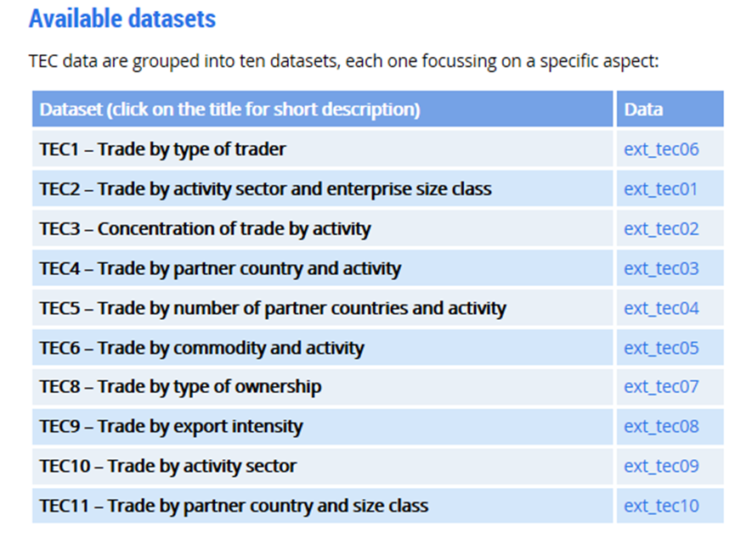
Data sets available on Eurostat website
Trade by enterprise characteristics (TEC)

Slide 15
New developments
Focus on the methodological work and quality improvement
New legal requirements from 2022:
  Compilation of all data sets at T+12
  Compilation of all data sets on a mandatory basis

Slide 16
Information at hand on EU official statistics on TEC:
Focus on Enterprise Charachteristics
Easy COMEXT- TEC
Compilers Guide on European statistics on international trade in goods by enterprise characteristics (TEC) 2020
Statistics explained - International trade in goods by enterprise size
User guide on European statistics on international trade in goods — 2016 edition
Compilers guide on European statistics on international trade in goods, 2017

